Slide 1
Internet of Things – Smart Cities – Household Application
Proactive Disease Avoidance

Slide 2
Problem
In a city, people in few communities often fall sick.
People at home are more prone to diseases if the following things are not properly managed:
  Water Quality
  Air Quality
  Timely Waste Disposal
Doctors are challenged by the frequency of disease occurrence.

Slide 3
Proposed Solution
Design and deliver an application to house holder in integration with Doctors, Waterworks, Air Quality and Waste Management Departments.
Sensors are deployed in each household, sensors will be integrated with the application.
The objective of this application is to make people life better and lead the life healthily in at most smarter way.
Four different types of sensors deliver data to the application.
Application will warn respective departments, if any sensor measurement hits threshold.
Also, Application enables house holder to keep the city clean.
Timely addressing the abnormalities of basic amenities will reduce probability of people becoming sick in a community.

Slide 4
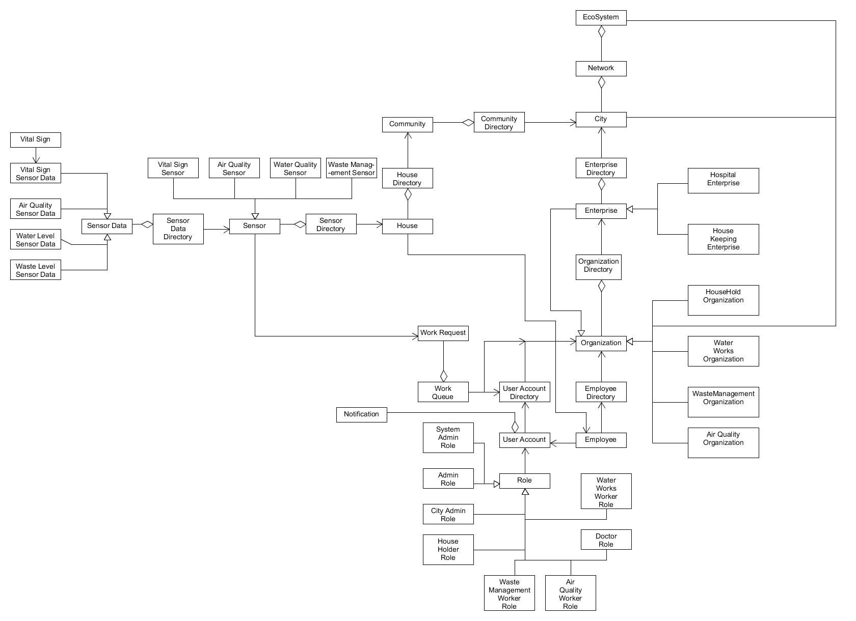
Object Model of Application

Slide 5
Sensor
Air Quality Sensor
Water Quality Sensor
Sensor Data
Sensor Data Directory
Sensor
Waste Management Sensor
Air Quality
Sensor Type
Waste Management Sensor
Water Quality
Vital Sign
Waste Level

Slide 6
City

Slide 7
Key Roles
House Holder Role
Doctor Role
City Admin Role
Water Works Worker Role
Air Quality Worker Role
Waste Management Worker Role

Slide 8
City Admin Role
Create Houses
Create Communities
Add Houses to communities
Map houses to employees
City Dashboard

Slide 9
House Holder Role
Manage Sensors
Manage Requests
Add Water Quality Sensor
Raise Request to Waste and Water Works Organization
Add Waste Level Sensor
View Status of work request raised by Sensors to respective organizations
Add Vital Sign Sensor
Add Air Quality Sensor

Slide 10
Doctor Role
Manage Vital Sign Requests
Pull report of Vital Sign History for analysis
View House Sensors generated data
Give medication to patient based on analysis of Vital Signs and House Sensor Data

Slide 11
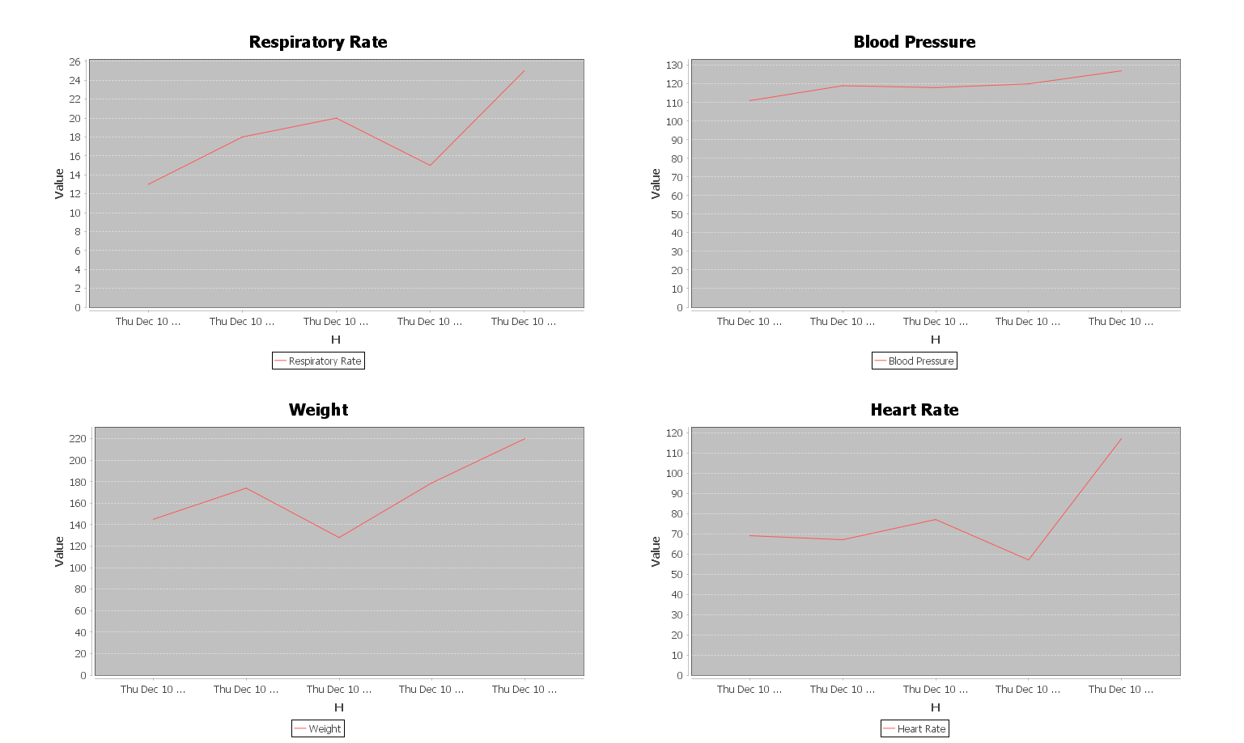
Features
Doctor an pictorially analyze householder’s or patient’s vital sign history as well as he can have look at house sensor’s generated data.

Slide 12
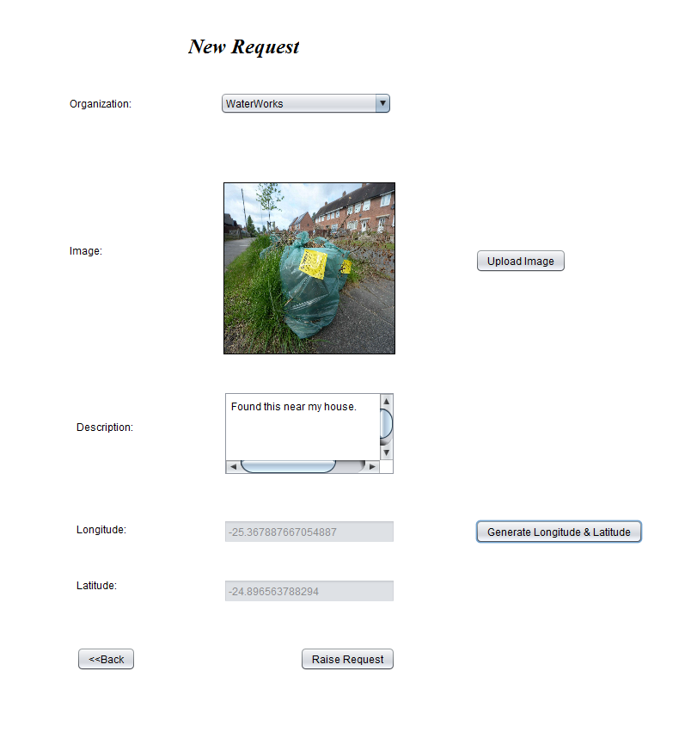
Features
House Holder can raise request to Waste Management Organization and Water works Organization if he finds any Water Leakage or Waste in city. House Holder must attach the picture of Waste or Water leakage.

Slide 13
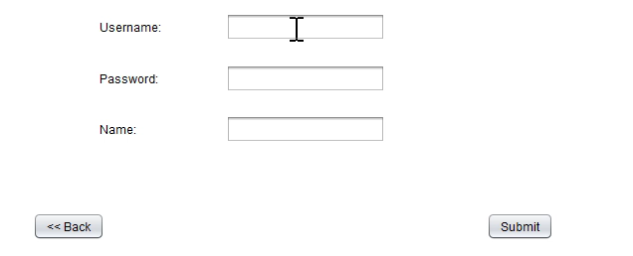
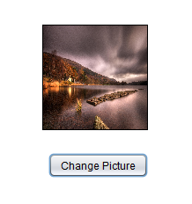
Extra Features
Unique User Name
  Application will show availability of desired username.
  Profile Picture for each user login
    User can change profile picture of his liking.
    Added a filter to allow only JPEG and PNG formats.

Slide 14
Cause and Effect Relationship
House holder will be less prone to diseases.
  Waste at home if not properly removed on time will have ramifications on person’s health. Bacteria will spread and it will totally start effecting the whole community.
Waste Management organization’s employee can manage his accordingly based on the requests received.
  The house keeping organization will have business advantage such as Waste Management employee don’t have to do to go and check all the waste bins in the city.
No one will be able to identify a room in house has impure air until they suffer with suffocation
  IOT Application will help identify air quality issues at right time and help avoid issues in right time.
Drinking water of less quality will cause a lot of health issues to people.
  As an effect of perfect water quality control system, health issues will be avoided.

Slide 15
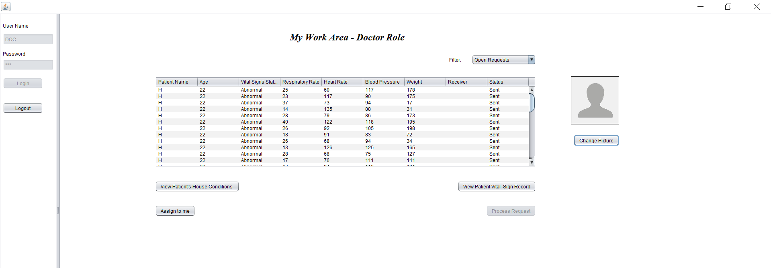
User Screens – Doctor Role

Slide 16
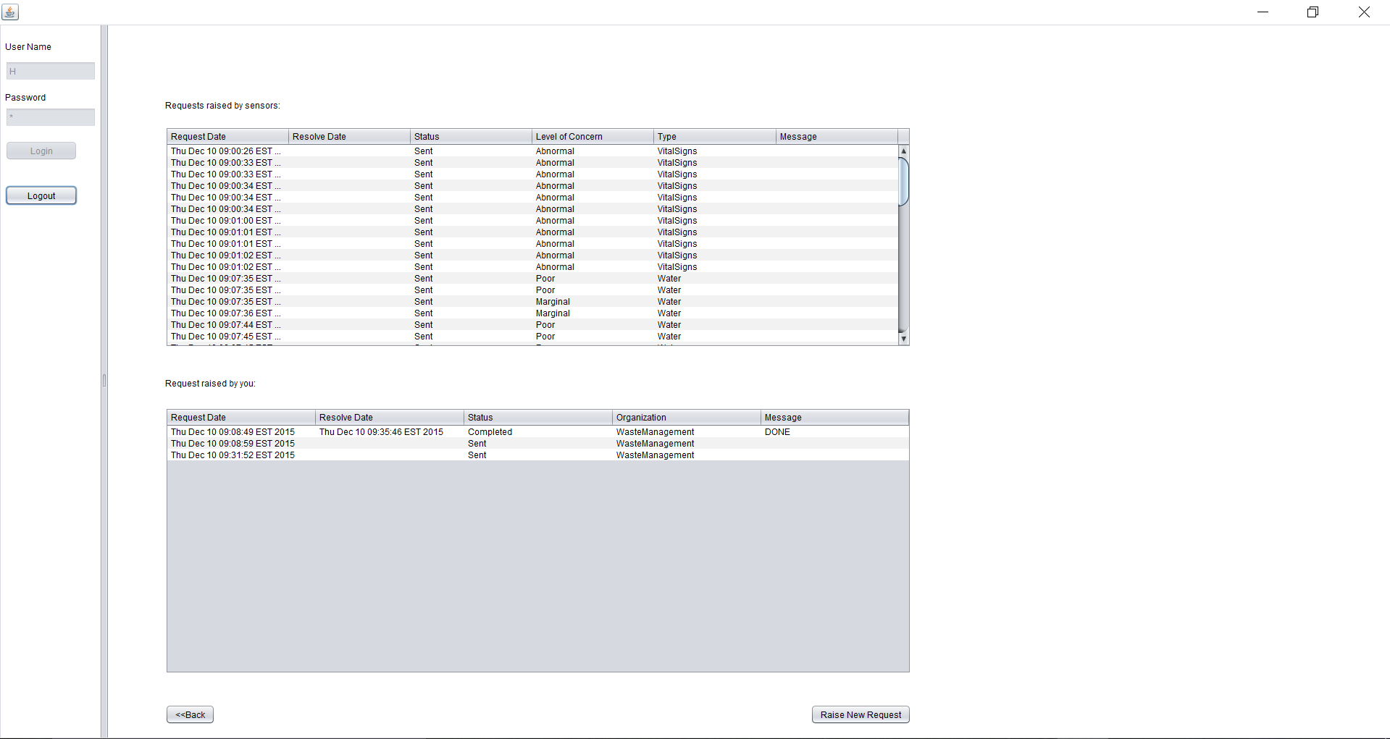
User Screens(cont.) – House Holder Role

Slide 17
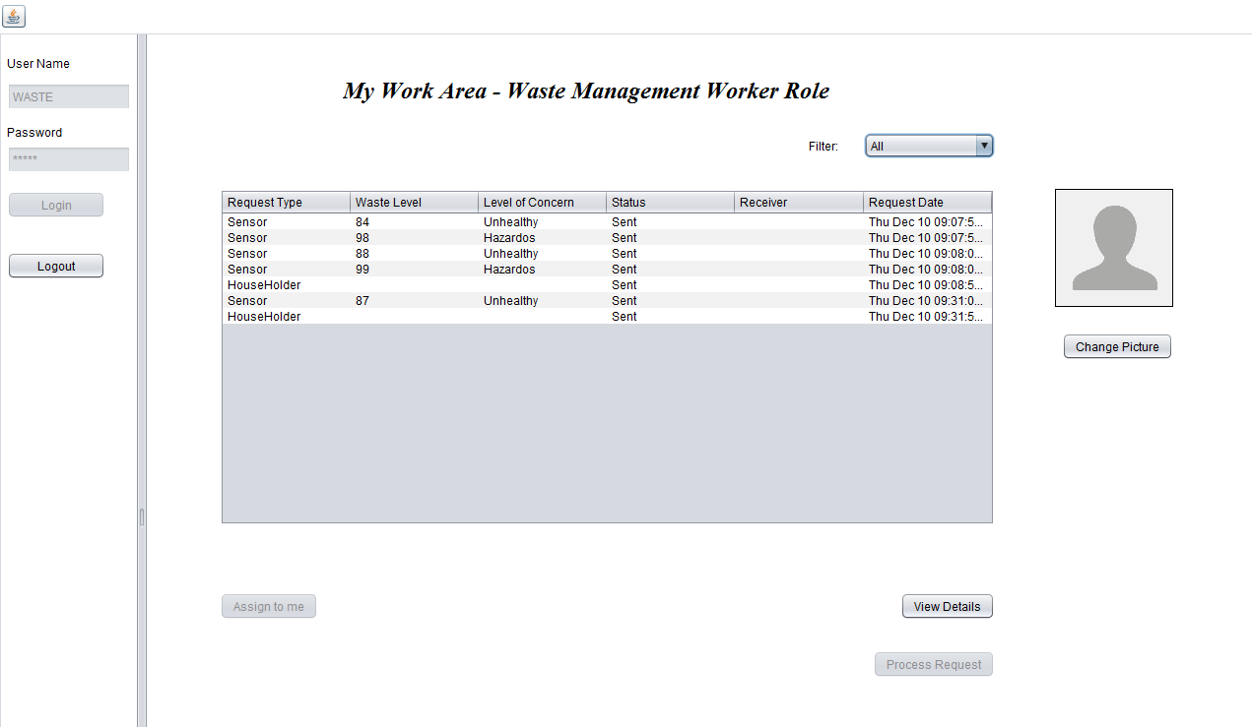
User Screens(cont.) – Waste Management Worker Role

Slide 18
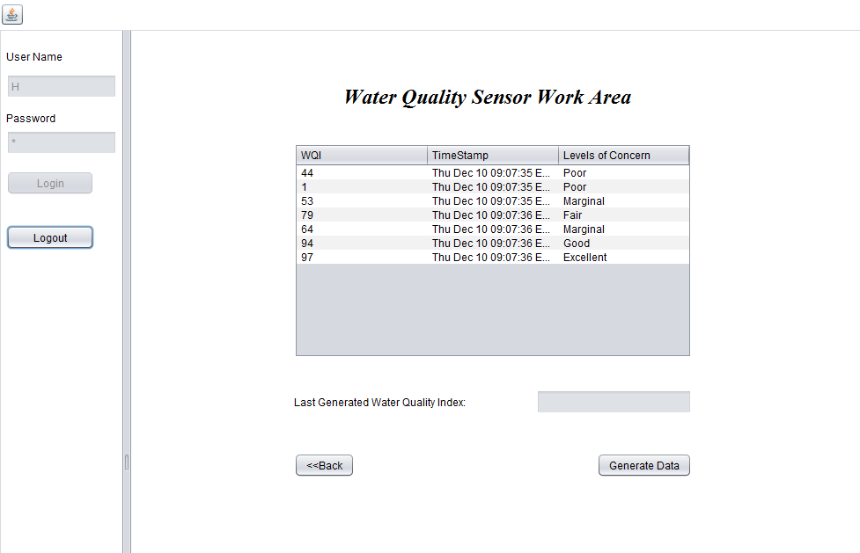
User Screens(cont.) – Sensor Work Area

Slide 19
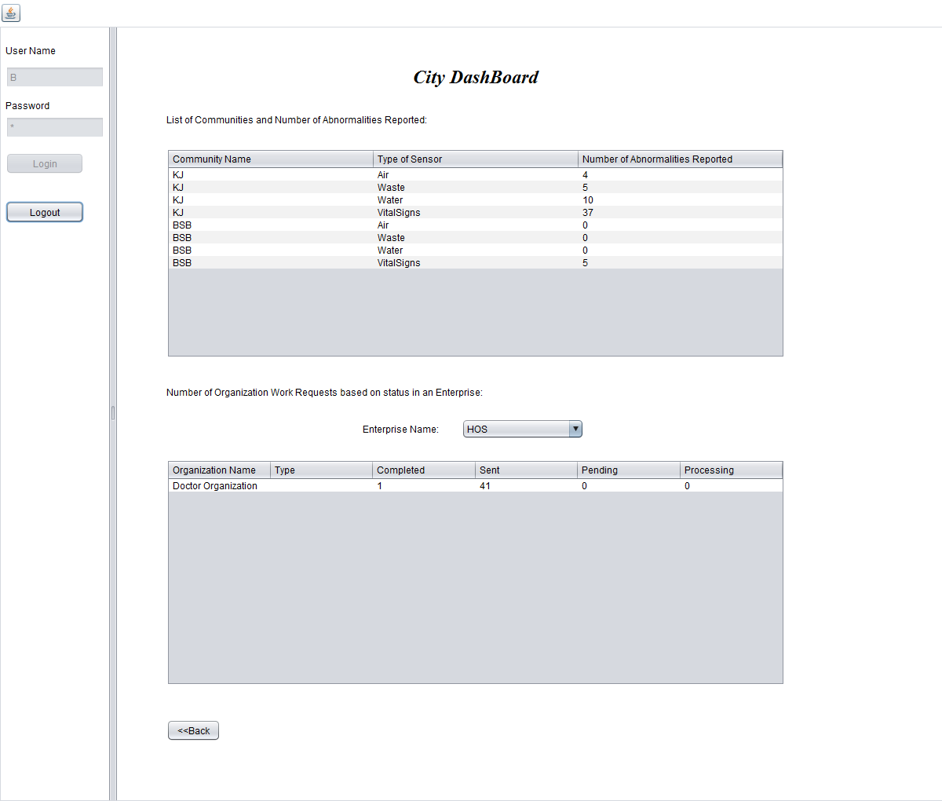
User Screens(cont.) – Sensor Work Area

Slide 20
Future Extensions to application
Integrating the works request with maps. Waste Management worker will be presented with map markers using latitude and longitude data from all active work requests. Maps will also present the shortest possible routes from worker’s starting point through all other work request locations.
If a user’s vital sign’s are seriously abnormal, emergency alarm goes off and raises alerts for ambulance.

